Slide 1
FM KASZk Hungary
Presentation of international activity

Slide 2
About us
Agricultural centre of Central-Hungary (centro agrícola Hungría central)
4 different schools
~1500 students
Basic profile: ISCED 3,4,5 education
Agriculture and farming / agricultura y ganadería
Equestry /equitación
Forestry/selvicultura
Mechanics/ mechánica
Food-industry/industria alimentaria
Canning and soft drink processing/envasado y procesamiento de bebidas gaseosas
Deboning/meat processing /deshuesado y procesamiento de carnes
Gardenery/ Jardinería
Landscaping- paisajismo
Land surveying- topogafía

Slide 3
ISCED System
International Standard Classification of education (2011)
ISCED level 0 – Early childhood education - Infantil
ISCED level 1 – Primary education- Primaria
ISCED level 2 – Lower secondary education- Secundaria
ISCED level 3 – Upper secondary education - (Bachillerato)
ISCED level 4 – Post-secondary non-tertiary education (Post bachillerato, pero todavía secundaria)
ISCED level 5 – Short-cycle tertiary education (terciaria)
ISCED level 6 – Bachelor’s or equivalent level (Grado)
ISCED level 7 – Master’s or equivalent level - Master
ISCED level 8 – Doctoral or equivalent level - doctorado

Slide 4
Education system in hungary
ISCED 4
Post-secondary non-tertiary education (4 years)
ISCED 1
Primary
education
(4 years)
ISCED 2
Lower secondary education
(4 years)
ISCED 4
Post-secondary non-tertiary education (4 years)
ISCED 6-8
Tertiary education
+1 year
ISCED 5
Short-cycle tertiary education
ISCED 3
Upper secondary education (3years)
+2 years
+1 year
ISCED4 GCSE
Schoolyear – 1st September – 15th June

Slide 5
training
Practical training prácticas | ISCED 3 Upper secondary education (3years) | ISCED 4 Post-secondary non-tertiary education (4 years) | ISCED 5 Short-cycle tertiary education (1-2 years)
After 1st year summer holiday | 4 weeks | - | 0/4 weeks
After 2nd year summer holiday | 4 weeks | 4 weeks | -
After 3rd year summer holiday | - | 4 weeks | not relevant
After 4 th year summer holiday | not relevant | - | not relevant
Our aim is to replace the summer holiday practical training with VET mobilities abroad
Nuestro objetivo es reemplazar las vacaciones de verano con movilidades prácticas en el extranjero)

Slide 6
Our qualifications
Field of education | Years of education | GCSE ESO | Vocational certificate/ Part qualification | NQR (post secondary vocational certificate) | Táncsics Mihály School (Vác) | Dr. Szepesi László School (Piliscsaba) | Bercsényi Miklós School (Budapest) | Varga Márton School (Budapest)
Butcher/meat processing Carnicero/procesamiento carnico | 3 | +2y | V.C. | GCSE + 1-2y |  |  | x
Canning and preserving/envasado y conservación | 3 | +2y | V.C. | GCSE + 1-2y |  |  | x
Fermentation and soft drink processing Fermentación y procesamiento de bebidas no alcohólicas | 3 | +2y | V.C. | GCSE + 1-2y |  |  | x
Farmer/ Granjeros | 3 | +2y | V.C. | GCSE + 1-2y | x
Equestrian/horse keeper Equitación/ cuidador de caballos | 3 | +2y | V.C. | GCSE + 1-2y | x
Forestry worker Trabajador de selvicultura | 3 | +2y | V.C. | GCSE + 1-2y |  | x
Agricultural mechanics Mecánica agrícola | 3 | +2y | V.C. | GCSE + 1-2y | x
Animal husbandry/ Cría de animales agricultura animal | 4 | Inc. | P.Q. | GCSE + 1y | x
Food industry/industria alimentaria | 4 | Inc. | P.Q. | GCSE + 1y |  |  | x
Gardenery and landscaping Jardinería y paisajismo | 4 | Inc. | P.Q. | GCSE + 1y |  |  |  | x
Environment protection and water management/protección ambiental y gestión del agua | 4 | Inc. | P.Q. | GCSE + 1y |  |  | x | x
Geodesy/ geodesia | 4 | Inc. | P.Q. | GCSE + 1y |  |  |  | x
Agriculture | 4 | Inc. | P.Q. | GCSE + 1y | x | x
Agricultural mechanincs/mecánica agrícola | 4 | Inc. | P.Q. | GCSE + 1y | x | x

Slide 7
Erasmus + activities from 2014
Erasmus + VET 2014
80 students,
81 colleagues
Erasmus + VET 2015
88 students,
20 colleagues
Erasmus + VET 2016
66 students,
12+10 colleauges
Erasmus + VET 2017
101 students,
9+12 colleauges
Erasmus + Teacher Training
11 colleagues
Aisec trainees since 2013
6 KA02 programs 2013-2018
Hosting VET mobilites

Slide 8
OUR MOBILITIES
Experience
Connections
Knowledge
Sharing
Possibility
Utilisation

Slide 9
PDCA CYCLE

Slide 10
Erasmus VET charter
Mobilities since 2014
Creation international strategy
Application in 2017 for VET charter
Successfull VET charter in 2018
Renewing international strategy
PDCA cycle *

Slide 11
VET charter - ESTATUTOS
Find your mission and visions of your institution (check the documents already existing)busca tu misión y visión de tu institución (comprobar documentos que ya existen)
Analyze your institution (SWOT)
Collect all your international activites /recopila todas tus actividades internacionales
Find the connections/encuentra conexiones
Analyze the impacts/analiza los impactos
Find your goals/ busca tus metas
Be concrete /sé concreto
Create the development goals/ crea el desarrollo de los objetivos
What are the tools/ cuáles son las herramientas
What are the impacts/ cuáles son los impactos
What are the results/cuales son los resultados
How can you integrate /cómo puedes integrarlos
Plan the monitoring/ planea la monitorización
PDCA

Slide 12
How we succeed?
We made an international stategy in 2014 and we renewed it in 2017 February
Hicimos una estrategia internacional en 2014 y la renovamos en Feb. 2017
We started with ECVET elements in our long term mobilities and we realized how important is it.
Empezamos con créditos ECVET en nuestras movilidades de larga duración y nos dimos cuenta de lo importante que es.
We wanted quality mobilities./ Queríamos movilidades de calidad
We knew that we are good in what we are doing/sabemos que somos buenos en lo que hacemos
We created a very effective project management team./creamos un equipo de dirección de proyecto muy efectivo
We needed good partners./necesitábamos buenos socios
We wanted to show our good examples./queríamos mostrar nuestros buenos ejemplos
We wanted to have a quality control and an action plan./queríamos tener control de calidad y un plan de acción
Why not try? If we won’t succeed we will learn a LOT! / ¿Por qué no probar? Si no lo conseguimos, aprenderemos UN MONTÓN.

Slide 13
Some advices / ALGUNOS CONSEJOS
It takes time Lleva tiempo
Once you have an international stategy you just need to renew it.Una vez que tienes una estategia internacional, simplemente necesitas renovarla
You can only profit if you put energy into quality mobilites. Sólo puedes sacar beneficios si pones energía en las movilidades de calidad
Work together with your colleagues- trabaja en equipo/junto con tus colegas
Listen to the student experiences- escucha a las experiencias de los estudiantes
Ask advices from international partners- pide consejo a los socios internacionales
Don’t want too much- no pidas/quieras demasiado
CHECK THE WEBPAGE OF YOUR INTERNATIONAL AGENCY comprueba la ´página web de tu agencia internacional
Believe in yourself! Cree en ti mismo

Slide 14
What we want to improve? qué queremos mejorar
To have an international webpage /tener una página web internacional
MSZ EN ISO 9001:2015 qualification – Titulación
To have a better program to create the students contracts – tener un mejor programa para crear contratos de aprendizaje de estudiantes.
To have a better solution to collect the practical diaries of the students – tener una solución mejor para recabar los diarios prácticos de los estudiantes.
To improve the ICT skills of our colleagues. Mejorar las habilidades TIC de nuestros colegas
To have more feedbacks from the students (not just EU survey and the diaries) Tener más retroalimentación de los estudiantes / no sólo las encuestas europeas y los diarios
To have more time Tener más tiempo

Slide 15
Our partners Nuestros socios
Denmark
Germany
France
Portugal
Spain
Finland
Sweden
UK
Austria

Slide 16
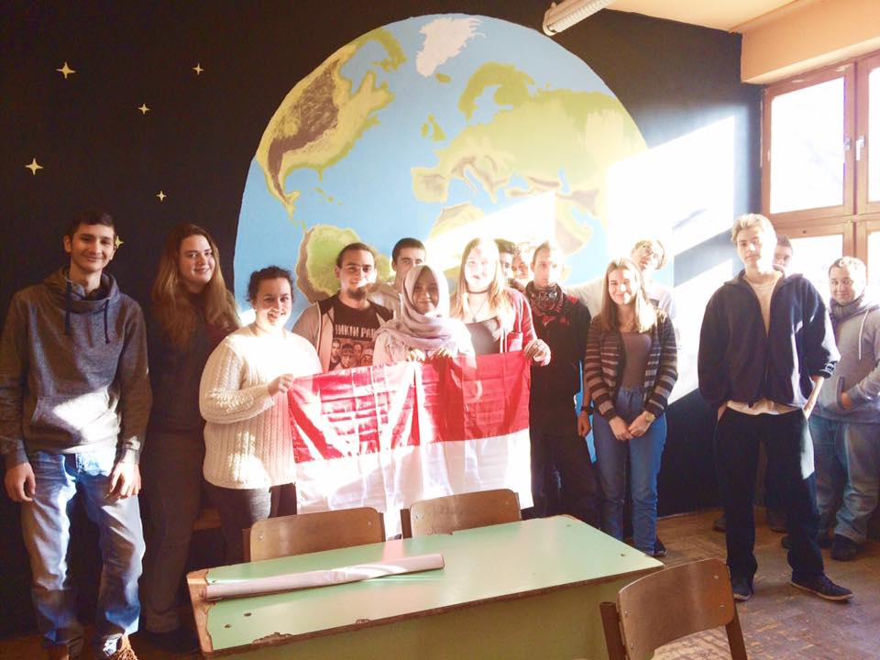
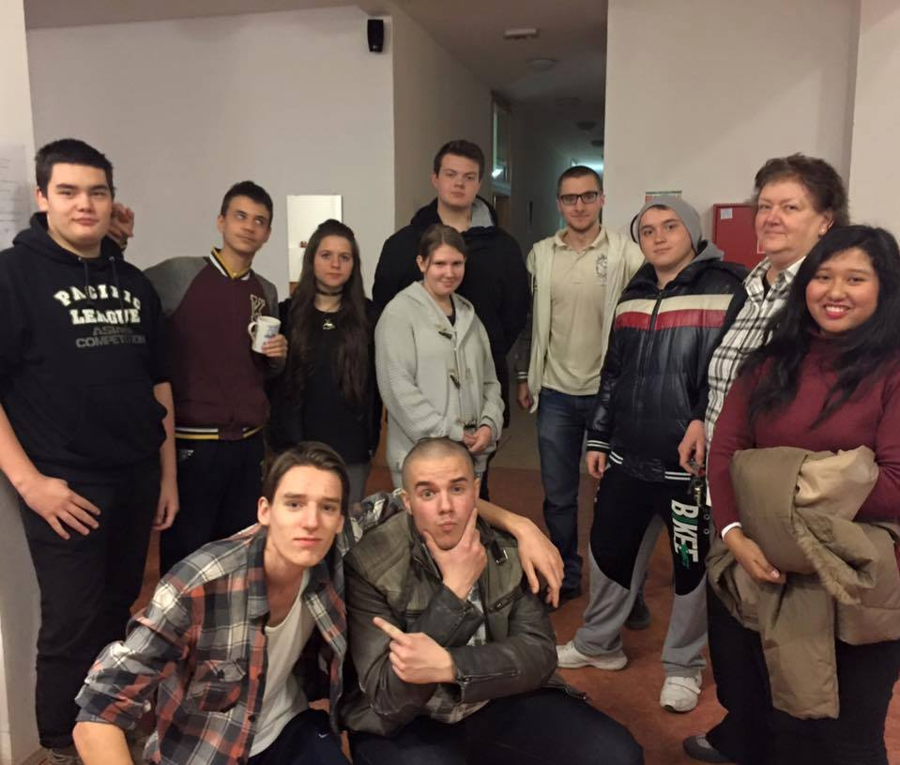
Hosting mobilites Mv. anfitrionas
Turkish groups – food industry, agriculture industria alimentaria, agricultura
Finish students – horticulture, forestry- horticultura y servicultura
Spanish students – canning and preserving – enlatado y conservación
AIESEC students – from all over the world- de todo el mundo – teaching practice (6 weeks) prácticas docentes

Slide 17
Thank you for your attention
Judit Emma TOTH
judit.toth3@gmail.com
toth.judit@kaszk.hu
+36302039576 (i am using WhatsApp)
www.kaszk.hu

